Slide 1

Entrepreneurship: Successfully Launching New Ventures
Sixth Edition
Chapter 13
Preparing for and Evaluating the Challenges of Growth
Notes:
If this PowerPoint presentation contains mathematical equations, you may need to check that your computer has the following installed:
1) MathType Plugin
2) Math Player (free versions available)
3) NVDA Reader (free versions available)

Slide 2
Learning Objectives
13.1 Describe how firms can properly prepare for growth.
13.2 Discuss the six most common reasons firms pursue growth.
13.3 Explain the importance of being able to manage the stages of growth.
13.4 Describe the challenges of firm growth, particularly those of adverse selection and moral hazard.

Slide 3
Three Things a Business Can Do to Prepare for Growth (1 of 3)
Appreciate the Nature of Business Growth
Important Realities
Not all businesses have the potential to be aggressive growth firms.
A business can grow too fast.
Business success doesn’t always scale.

Slide 4
Three Things a Business Can Do to Prepare for Growth (2 of 3)
Stay Committed to a Core Strategy
It is important that a business not lose sight of its core strategy as it prepares to grow.
If a business becomes distracted or starts pursuing every opportunity for growth that it’s presented, it can easily stray into areas where it’s at a disadvantage.

Slide 5
Three Things a Business Can Do to Prepare for Growth (3 of 3)
Planning for Growth
A firm should establish growth-related plans.
Writing a business plan greatly assists in preparing growth plans.
It’s also important for a firm to determine, as soon as possible, what its growth strategies will be.

Slide 6
Warning Signs That a Business is Growing Too Fast
Table 13.1 10 Warning Signs That a Business Is Growing Too Fast
Borrowing money to pay for routine operating expenses
Extremely tight profit margins
Over-stretched staff
Declining product quality
E-mail and text messages start going unanswered
Customer complaints are up
Employees dread coming to work
Productivity is falling
Operating in a “crisis” mode becomes the norm rather than the exception
Those working with the business’s financial structure are starting to worry

Slide 7
Reasons for Growth (1 of 3)
Reason for Growth | Explanation
Economies of scale | Occur when increasing production lowers the average cost of each unit produced.
Economies of scope | Occur when the scope (or range) of a firm’s operations creates efficiencies.

Slide 8
Reasons for Growth (2 of 3)
Reason for Growth | Explanation
Market Leadership | Occurs when a firm holds the number one or the number two position in an industry or niche market in terms of sales volume.
Influence, Power, and Survivability | Larger businesses usually have more influence and power than smaller firms.

Slide 9
Reasons for Growth (3 of 3)
Reason for Growth | Explanation
Accommodate the Growth of Key Customers | Sometimes firms are compelled to grow to accommodate the growth of a key customer.
Attract and Retain Talented Employees | Growth is a firm’s primary mechanism to generate promotional opportunities for employees.

Slide 10
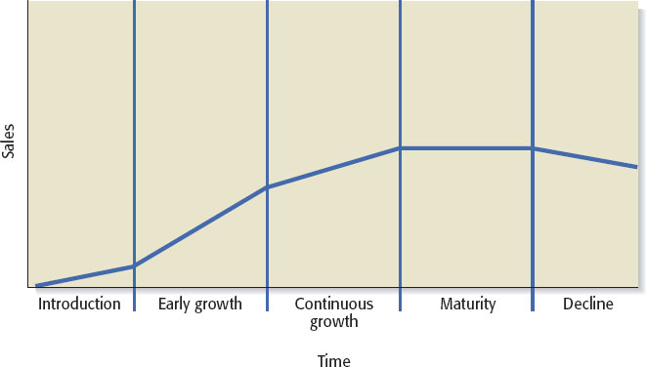
Managing Growth
It’s important for a business owner to know the stages of growth, along with the unique opportunities and challenges that each stage entails.
Figure 13.2 organizational life cycle

Slide 11
Stages of Growth (1 of 5)
Introduction Stage
Start-up phase where a business determines what its core strengths and capabilities are.
The main challenge is to make sure the initial product or service is right.
It’s important to document what works and what doesn’t work during this stage.

Slide 12
Stages of Growth (2 of 5)
Early Growth Stage
Generally characterized by increasing sales and heightened complexity.
Two important things must happen for a business to be successful in this stage.
The founder must start working “on the business” rather than “in the business.”
Increased formalization must take place, and the business has to start developing policies and procedures.

Slide 13
Stages of Growth (3 of 5)
Continuous Growth Stage
The need for structure and formalization increases.
Often the business will start developing related products and services.
The toughest decisions take place in this stage.
One tough decision is whether the owner of the business and the current management team have the experience and the ability to take the business further.

Slide 14
Stages of Growth (4 of 5)
Maturity Stage
A business enters the maturity stage when its growth stalls.
At this point, a firm is typically more intently focused on managing efficiently than developing new products.
Well-managed firms often look for partnering opportunities or opportunities for acquisitions or licensing deals to breathe new life into the firm.
If new growth cannot be achieved through a firm’s existing product mix, the “next generation” of products should be developed.

Slide 15
Stages of Growth (5 of 5)
Decline Stage
It is not inevitable that a business enter the decline stage.
Many American businesses have long histories and have adapted and survived over time.
A business’s ability to avoid decline hinges on the strength of its leadership and its ability to adapt over time.

Slide 16
Challenges of Growth
Two categories of challenges for firm growth
Managerial Capacity Problem
Day-to-Day Challenges of Growing a Firm

Slide 17
Managerial Capacity Problem (1 of 6)
Managerial Capacity
Firms are collections of productive resources that are organized in an administrative framework.
As a firm goes about its routine activities, it recognizes opportunities to grow.
The problem with this scenario is that firms are not always prepared or able to grow, because of limited “managerial capacity.”

Slide 18
Managerial Capacity Problem (2 of 6)
A Firm’s Administrative Framework
A firm’s administrative framework consists of two kinds of services that are important to firm growth.
Entrepreneurial services generate new market, product, and service ideas, while managerial services administer the routine functions of the firm and facilitate the profitable execution of new opportunities.
New product and service ideas require substantial managerial services (or managerial capacity) to be successfully implemented.
This is a complex problem because if a firm has insufficient managerial services to properly implement its new product and service ideas, it can’t grow.

Slide 19
Managerial Capacity Problem (3 of 6)
The reason a firm can’t quickly increase its managerial services (to take advantage of new product or service ideas) is that it is expensive to hire new employees, it takes time for new hires to be socialized into the culture of a firm, and it takes time for new employees to acquire firm-specific skills and establish trusting relationships with other members of the firm.
When a firm’s managerial resources are insufficient to take advantage of its new product and service opportunities, the subsequent bottleneck is referred to as the managerial capacity problem.

Slide 20
Managerial Capacity Problem (4 of 6)
Additional Challenges
As a firm grows, it is faced with the dual challenges of adverse selection and moral hazard.
Adverse selection means that as the number of employees a firm needs increases, it becomes increasingly difficult for the firm to find the right employees, place them in appropriate positions, and provide adequate supervision.
Moral hazard means that as a firm grows and adds personnel, the new hires typically do not have the same ownership incentives as the original founders, so the new hires may not be as motivated as the founders to put in long hours and may even try to avoid hard work.

Slide 21
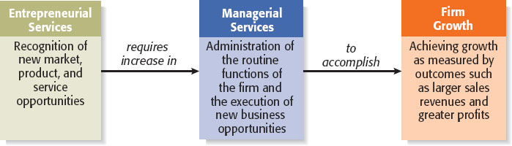
Managerial Capacity Problem (5 of 6)
Figure 13.3 Basic Model of Firm Growth

Slide 22
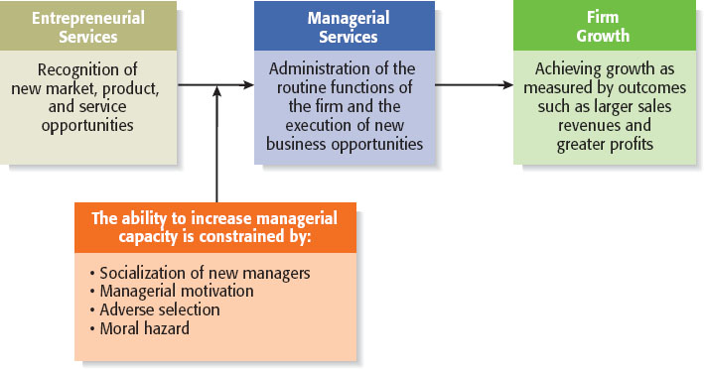
Managerial Capacity Problem (6 of 6)
Figure 13.4 impact of the managerial capacity problem
Source: Based on material in E. T. Penrose, The Theory of the Growth of the Firm (New York: Oxford University Press, 1959).

Slide 23
Day-to-Day Challenges of Growing a Firm (1 of 2)
Challenge | Explanation
Cash Flow Management | A firm requires an increasing amount of cash as it grows.
Price Stability | If growth comes at the expense of a competitor’s market share, a price war could ensue.

Slide 24
Day-to-Day Challenges of Growing a Firm (2 of 2)
Challenge | Explanation
Quality Control | An increase in firm activity can result in quality control issues if a firm is not able to increase its resources to handle the extra work.
Capital Constraints | Capital constraints are an ever-present problem for growing firms.

Slide 25

Copyright

